Slide 1
V10 Fundamentals
Code Generation and Debugging

Slide 2
Assessment Creation process
Objective
At the end of this session you will be able to :
Understand Guidewire code generation process
Differentiate between incremental and bulk code generation
Use Studio debugger

Slide 3
Code Generation

Slide 4
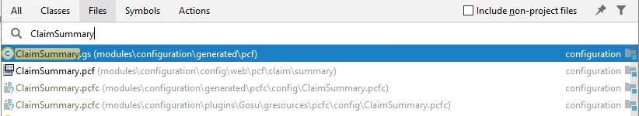
Code Generation
Code generation process uses resources defined in XML format (PCF files, entities, typelists etc) and generates Gosu or Java classes
Code generation happens within Guidewire studio.
The generated classes are available in studio and can be debugged
Two types
Incremental code generation – Processes one or more changed files in isolation
Bulk code generators – process a set of resources as a whole for generation

Slide 5
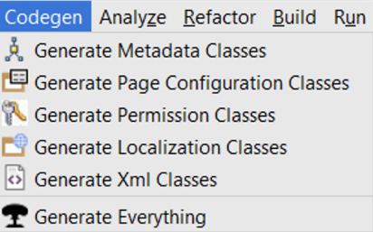
Incremental vs Bulk generation
Incremental
Invoked – on save or during project make
Supported Guidewire Resources
PCF Files
Entities
Typelists
Permissions
Bulk
Invoked – from CodeGen menu and During Project Rebuild
Supported Guidewire Resources
All Resources

Slide 6
Output of Generation
All generated resources are in configuration/generated folder
Following files are generated for a PCF file:
.gs file – Gosu class that represents the PCF type
.pcfc file – Binary file that describes the PCF file for the new PCF runtime
Expression.gs – Gosu class that contains all container and widget expressions
Following file gets generated for an entity:
.java class – Java class that represents the entity
The Expressions.gs and .java files are available in studio and can be debugged

Slide 7
UI Debug Options

Slide 8
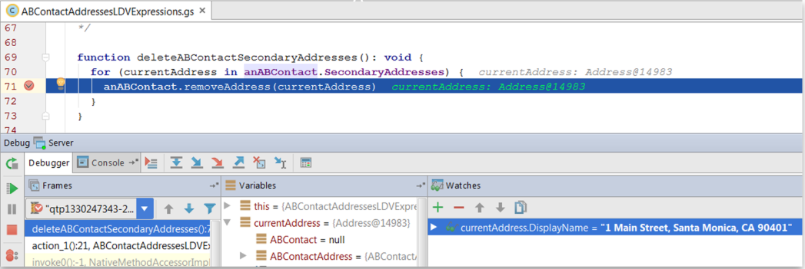
Breakpoints
When breakpoint is hit –
Studio suspends code execution
File with breakpoint opens in studio
Breakpoint line highlighted in blue
Debug tool window opens
You can debug
Plain old Gosu and Java resources such as Gosu rules, Enhancements and classes
Generated Gosu and Java classes generated by code generation

Slide 9
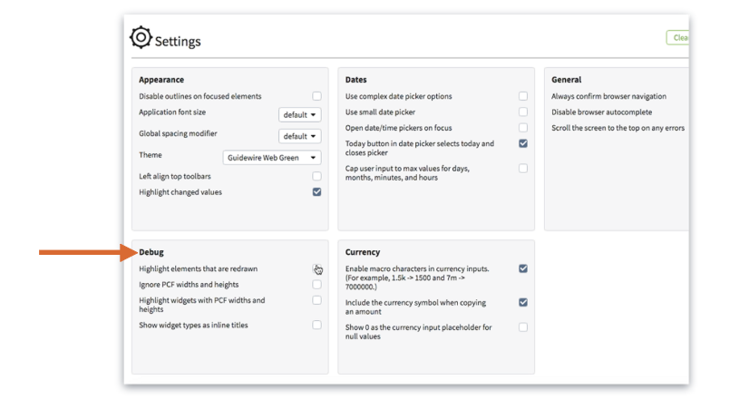
UI Debug options – Under settings menu

Slide 10
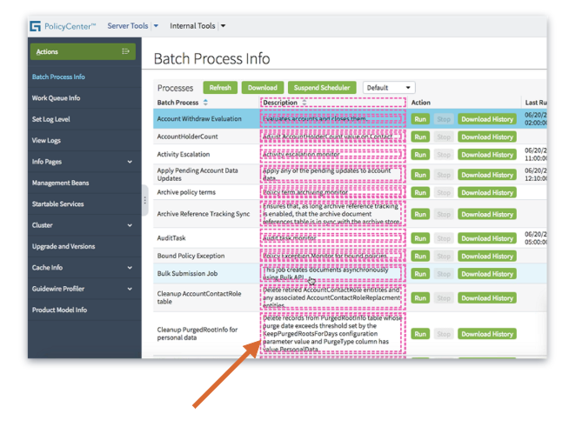
Highlighting widgets with PCF widths and heights
Developers are encourages to not
set width and height values for UI
Elements
The Highlight widgets with PCF
Widths and heights option can be used
to show developers UI elements that
have set width or height values that
should be changed to dynamic

Slide 11
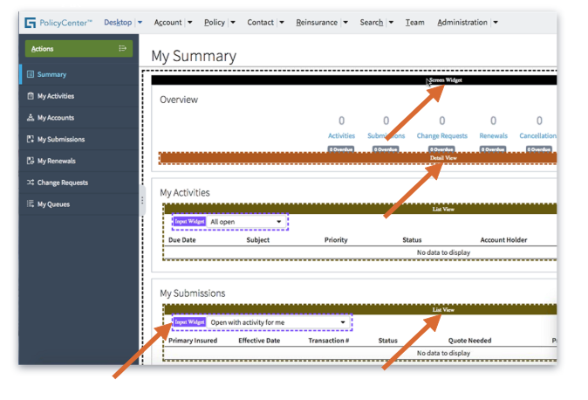
Show widget types as inline titles
The show widget types as inline
titles option makes it easy for
developers to see all the elements
on the screen.

Slide 12
PCF Methods
A PCF method is a plain old Gosu function that is local in a PCF file
is local (private) in the PCF file that defines it (not even referenced files can access it)
cannot be debugged at the place of definition(you have to open the generated <PCFFileName>Expressions.gs file after code generation, locate the method and put the breakpoint there)
Is called from a widget property (eg: action, value, available, editable etc)
The logic the function implements is typically tied to one or more widgets in that PCF file and it is not needed anywhere else. For example :
Determining the label (View or View/Edit) for a button
Determining if a TextInput widget is editable or not editable
Executing some initialization logic after navigating to a location

Slide 13
Thank you

